Slide 1



PREDICTING HOSPITAL READMISSIONS AND PATIENT OUTCOMES USING MIMIC-III AND DIABETES DATA
Predicting Patient Outcomes: Uncovering Insights from Hospital Readmissions
CAPSTONE PROJECT

Slide 2


Project Overview :
The goal of this project is to analyze hospital readmissions and patient outcomes by combining two datasets:
Diabetes 130-US hospitals dataset (readmissions data).
MIMIC-III Clinical Database (ICU data).
This will allow us to investigate which clinical factors affect readmissions, explore the relationships between various patient-level data, and build models to predict patient outcomes based on combined datasets.

Slide 3

Data Preview
The datasets given for the analysis includes the data of 10 years (1999-2008) covering more than 1,00,000 patients from 130 hospitals in United States.
Diabetes 130-US hospitals dataset (readmissions data)
Total Rows: 101766
Total Columns : 50
MIMIC-III Clinical Database (ICU data)
Total Rows: 100000
Total Columns : 18
www.reallygreatsite.com

Slide 4
Diabetes 130-US hospitals dataset (readmissions data)
Patient identifiers: - encounter _id, patient_nbr
Patient demographics:- race, gender, age, payer_code
Admission and Discharge details:- admission_source_id, admission_type_id, discharge_disposition_id
Patient medical history:- number_outpatient, number_inpatient, number_emergency
Patient Admission details: - medical_speacialty, diag_1, diag_2 and diag_3, time_in_hospital, number_diagnoses, num_lab_procedures, num_procedures, num_medicationsClinical
Results :- max_glu_serum, Alcresult
Medication Details :- diabetesMed, change, 23 features for medications
Readmission Indicator: - readmitted

Slide 5
MIMIC-III Clinical Database (ICU data)
Patient identifiers: - Patient_ID, ICU_Admission_ID
Other Derails: - ICU_Length_of_Stay , Diagnoses, Number_of_Lab_Tests
Vital Signs: - Blood_Glucose, Hemoglobin, WBC, Heart_Rate, Blood_Pressure_Systolic, Blood_Pressure_Diastolic, SpO2, Respiratory_Rate, Temperature
Medication Details :- Medications, Number_of_Medications
Readmission Indicator: - Readmission Flag

Slide 6
Data preprocessing -
•Identified null values in the data sets.
•Filled the ‘?’ and other null values with respective column and group of columns using data engineering.
•Dropped the irrelevant columns and columns with high missing values as weight, payer code etc.
•Used Data Featuring techniques for the exploratory data analysis.

Slide 7
Challenges encountered -
Uncovered critical factors driving readmissions through data integration.
Delved deep into patient-level data to reveal hidden patterns.
Built predictive models to improve patient outcome forecasting.

Slide 8
EXPLORATORY DATA ANALYSIS

Slide 9
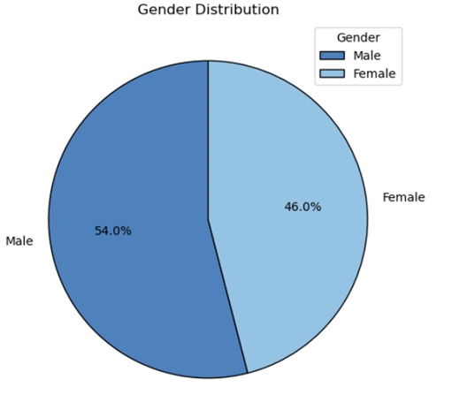

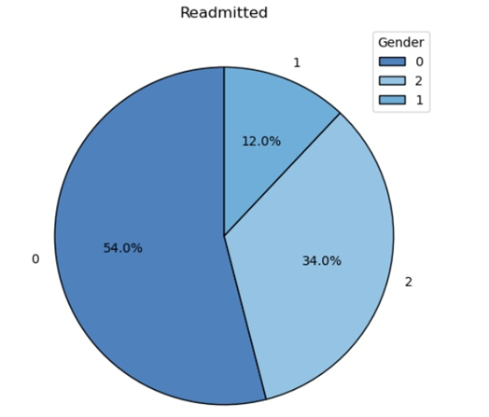
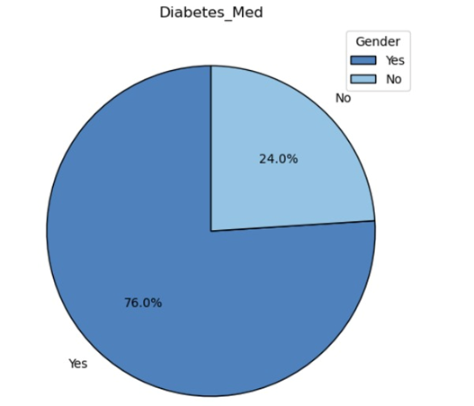
UNIVARIATE
ANALYSIS
01
02
03
2 = >30 readmissions 48594
1 = <30 readmissions 15930
0 = no readmissions 76801

Slide 10
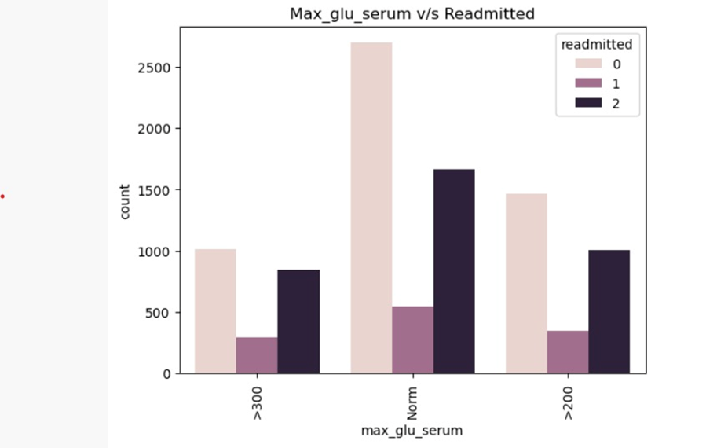
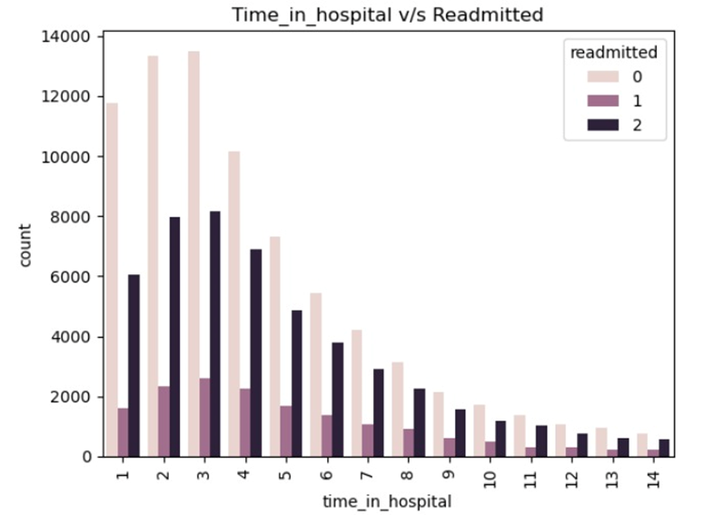
BIVARIATE ANALYSIS
01
02

Slide 11
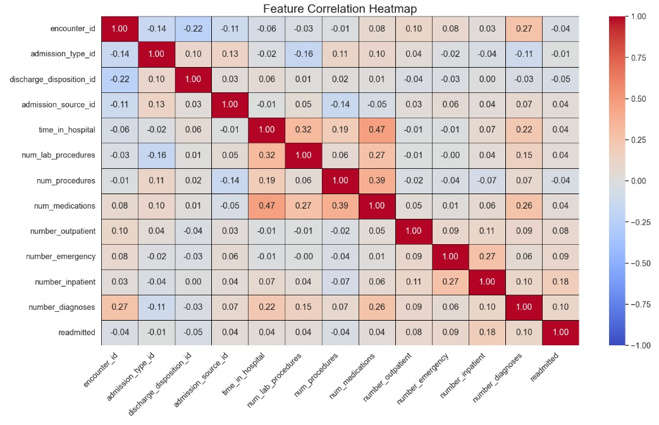

Slide 12
01
02

Slide 13
01
02

Slide 14
01
02

Slide 15
01
02

Slide 16
Thank
You

